Slide 1

CHAPTER 11 Load Balancing
|Cloud Computing

Slide 2
Introduction
What is Load Balancing:
Distributes workloads evenly across computing resources.
Ensures no single resource is overloaded.
Improves performance, reliability, and scalability.
Importance of Load Balancing in Cloud Computing
Optimization: Maximizes resource utilization and throughput.
Scalability: Enables dynamic resource provisioning.
Reliability: Reduces risk of total system failure.
Flexibility: Supports distributed cloud architecture.
Key Objectives of Load Balancing
Optimize resource utilization.
Minimize response time.
Avoid resource overloading.
Maintain uninterrupted service.

Slide 3
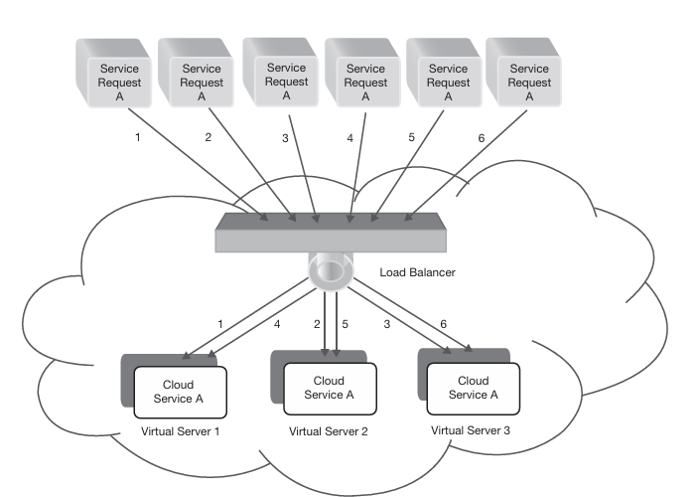
Load Balancing Architecture
Load balancer acts as an abstraction layer over resources.
Front-end node: Distributes requests to back-end nodes.
Back-end nodes: Virtual machines and physical servers process requests.
Types of Load Balancing
Hardware-based: Multi-layer switch systems (expensive but efficient).
Software-based: Domain Name System (DNS) servers (cost-effective and flexible).

Slide 4
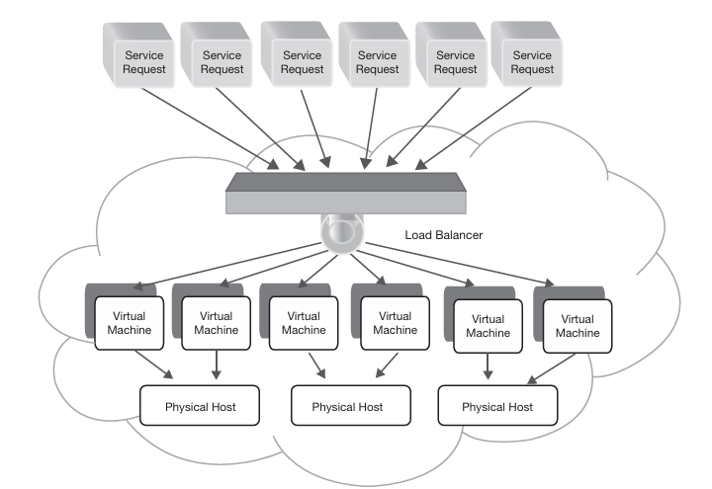
Levels of Load Balancing
VM Provisioning: Allocates service requests to virtual machines.
Resource Provisioning: Maps requests to physical resources.

Slide 5
Components of Load Balancing
What we can use for load balancing:
Application server instances (CPU, memory).
Storage resources.
Network switches.
Core services: DNS, TCP, HTTP/HTTPS.

Slide 6
Challenges of Load Balancing
Implementation complexity.
Maintaining performance during high traffic.
Adapting to unpredictable workload patterns.

Slide 7
Goals of Load Balancing
Load balancing ensures the efficient distribution of workloads across computing resources in cloud systems. Key objectives include:
Improving System Performance
Prevents resource overloading while others remain underutilized.
Maintains a stable and high-performing system with balanced load distribution.
Maximizing Fault Tolerance
Enhances system resilience by redirecting traffic from failed nodes to functional ones.
Ensures uninterrupted user experience despite node failures.
Accommodating Scaling
Supports system growth or shrinkage by redistributing workloads accordingly.
Adjusts load among new nodes or scales down without affecting performance.
Ensuring Application Availability
Prevents application downtime by routing traffic to less-utilized nodes.
Enhances overall application reliability.

Slide 8
Categories of Load Balancing
Static Approach:
Distributes loads based on predefined rules without considering the system's current state.
Uses algorithms like Round Robin and Weighted Round Robin.
Dynamic Approach:
Uses feedback from resources to distribute loads dynamically based on real-time conditions.
Actively monitors resource statuses.
Redirects traffic if a node fails or becomes overloaded.

Slide 9
Dynamic Load Balancing
Dynamic load balancing can be implemented in the following ways:
Distributed Approach: All nodes share the load-balancing responsibility.
Cooperative: Nodes work together to achieve a common goal (e.g., response time improvement).
Non-Cooperative: Nodes operate independently to meet local objectives.
Non-Distributed Approach: Managed by one or a cluster of central nodes.
Centralized: A single node controls all load balancing but risks bottlenecks and single points of failure.
Semi-Distributed: A cluster of nodes divides tasks, with each cluster operating in a centralized manner.

Slide 10
Parameters for Load Balancing
Resource Utilization
Ensures even distribution of workloads to avoid overloading any single resource.
Response Time
Minimizes the delay in handling service requests to enhance user experience.
System Health
Monitors and manages node failures to maintain system efficiency.
Associated Overhead
Reduces inter-node communication and task movement to optimize performance.
Scalability
Supports system expansion or reduction based on application demands.

